Slide 1
Alibaba Ecommerce Company
Presented by: Dipesh Tha Shrestha
Presented To: Kushal Regmi

Slide 2
Introduction
Alibaba.com is a Chinese multinational technology company specializing in e-commerce, retail, Internet, and technology.
Founded on 28 June 1999, in Hangzhou, Zhejiang.
The company provides consumer-to-consumer (C2C), business-to-consumer (B2C), and business-to-business (B2B) sales services via web portals, as well as electronic payment services, shopping search engines and cloud computing services. It owns and operates a diverse portfolio of companies around the world in numerous business sectors.

Slide 3
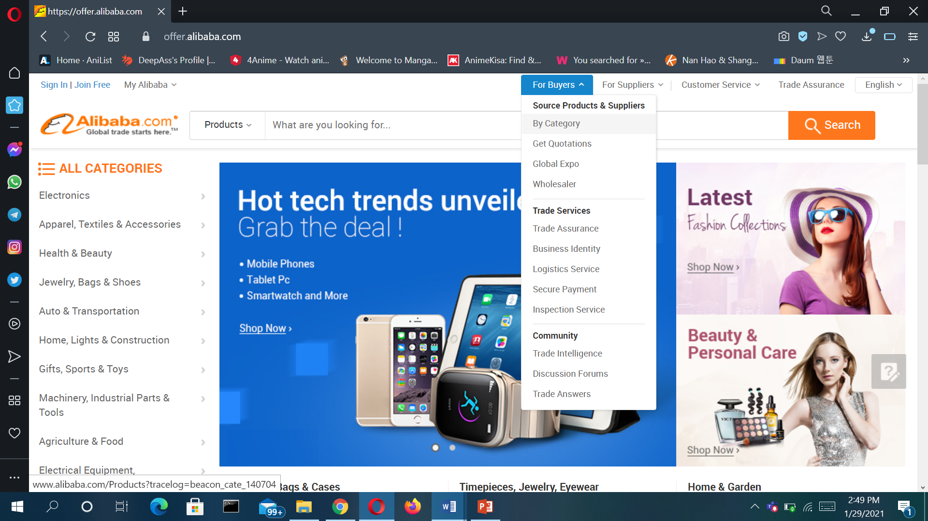
Official site of Alibaba

Slide 4
Features
Allows them to talk with the sellers freely
Everything is trackable
Share your purchases
Internal re-marketing
live stream shopping
Attracting Sellers by Eliminating listing fees
Multi language sites

Slide 5
Types of e-commerce that have been used in Alibaba
Alibaba B2B
Alibaba.com was launched in 1999 in Hangzhou by Jack Ma, a former English teacher, along with a group of 17 friends. It is a business-to-business trading platform, connecting manufacturers and wholesalers with buyers from around the world.
Merchants pay annual sellers' fees and sales commissions to Alibaba. They can list a limited number of products for free but have the option to pay for a range of benefits such as greater exposure on the site and unlimited product listings.

Slide 6
Types of e-commerce have been used
2. Taobao C2C
While Alibaba.com is business-to-business, Taobao is business-to-consumer or consumer-to-consumer focused, enabling small businesses and individuals to open online stores.
Taobao.com has grown to become China's largest shopping website. Launched in 2003, Taobao lists hundreds of millions of products and services from millions of sellers.
Taobao doesn't charge transaction fees and the site is free for merchants to join, a policy that helped the site gain its enormous user base in China. Its main revenue source is advertising fees paid by merchants who want to stand out from the literally millions of competitors on the site.

Slide 7
Types of e-commerce have been used
3. Tmall B2C
Tmall is a Chinese-language website for business-to-consumer (B2C) online retail.
It is a platform for local Chinese and international businesses to sell brand name goods to consumers.
Tmall is the part of Alibaba that most resembles eBay and Amazon, which also collect transaction fees from third-party merchants.

Slide 8
Business models being used in Alibaba
The company provides consumer-to-consumer (C2C), business-to-consumer (B2C), and business-to-business (B2B) sales services via web portals, as well as electronic payment services, shopping search engines and cloud computing services.

Slide 9
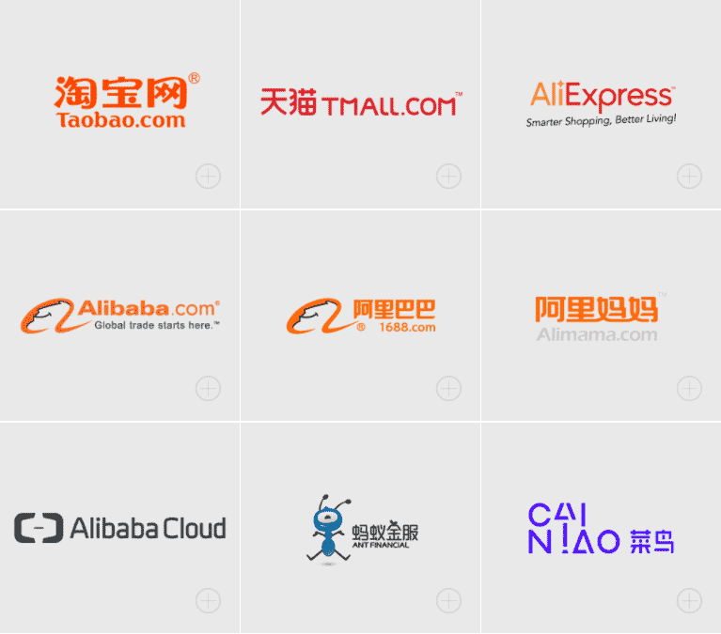
Alibaba Sites
Alibaba.com.
Alibaba Cloud.
AliExpress.
AliOS.
Alipay.
AliGenie.
Taobao.
Tmall.

Slide 10
How to Buy from Alibaba
In order to start buying from Alibaba, it’s important to know just how to buy from Alibaba! Here are the steps to successfully make purchases on the website:
Create and verify an Alibaba account
Search for products based on different categories
Contact suppliers
Negotiate minimum order quantity
Verify offered price to avoid dealing with hidden charges
Negotiate price and payment method
Ask for samples
Confirm quality of products through samples
Make your purchase
Resell the product on your own online store after it arrives

Slide 11
Advantages of Buying from Alibaba:
Ability to design your own custom-made products
Ability to buy bulk wholesale products directly from manufacturers
Affordable prices
Increased control over product packaging
Lower manufacturing costs
Huge number of manufacturers and suppliers to choose from
One-stop shopping option

Slide 12
Disadvantages of Buying from Alibaba:
Higher upfront cost
Reality of products may differ from display images on website
Maximum order amount needed for discounted pricing

Slide 13
Strategy Alibaba can take to provide better services
Site speed
Use High-Quality Photographs and Good Product Descriptions
Improve Your Social Media Strategy
Build Advertising Strategies
Implement User-Generated Content
Increase E-commerce Search Usability

Slide 14
New technologies company has implemented
Alibaba used an intelligent operating platform, DC Brain, to optimise the performance of the 200-plus global internet datacentres (IDCs) hosting its online stores in areas including energy consumption, temperature, energy efficiency, and reliability.
Alibaba use global tracking system. It uses Internet of Things (IoT) and blockchain technology to verify products purchased by consumers through dual authentication and two-way encryption, while tracking the real-time location of items through location-based services and GPS.

Slide 15
New technologies company has implemented
The mobile-based technology(Smart touch) was made available to assist shoppers that are visually impaired. The application can understand different mobile user interfaces through AI and intelligent human-machine-interaction (HMI) technology to provide the relevant audio and haptic interactions.
Alibaba developed an AI translation tool in a bid to remove language barriers between sellers and buyers. Online chatbot provides instant translation from English to Thai, Vietnamese, Indonesian, and vice-versa.

Slide 16
Marketing and Advertising techniques used
Distribution strategy in the Marketing strategy of Alibaba –
Technologically advanced and robust infrastructure has helped the company in providing a seamless and easy to access and communicate, sell, buy the different offerings of the sellers/ buyers anywhere, anytime across the world.
Competitive analysis in the Marketing strategy of Alibaba –
Alibaba’s diversified business portfolio is helping the company to be competitive while the e-commerce market is overcrowded with local, national and international players like Amazon, eBay etc

Slide 17
Marketing and Advertising techniques used
Customer analysis in the Marketing strategy of Alibaba –
Customers of Alibaba are new-age, tech-savvy, Gen Y and Z customers to whom their time, the convenience of buying and selling, maintaining their lifestyle is more important than it ever had.
Market analysis in the Marketing strategy of Alibaba –
Alibaba has the presence in China and various international markets. It had 423 MM active buyers in the year 2015-16 who helped the company in surpassing 3 trillion Renminbi (RMB) of Gross Merchandise Value. Alibaba is ruling the market in China but in other Developing and Developed nations, it is still struggling to emerge as a most preferred e-commerce player.

Slide 18
Marketing and Advertising techniques used
Promotion Strategy of Alibaba company
The company also promotes its services via internet promotion strategy such as public relations, direct marketing, and discounts for certain items during special days such as festivals, media advertising and sponsoring of events to attract awareness of Alibaba .

Slide 19
Thank you

